Slide 1
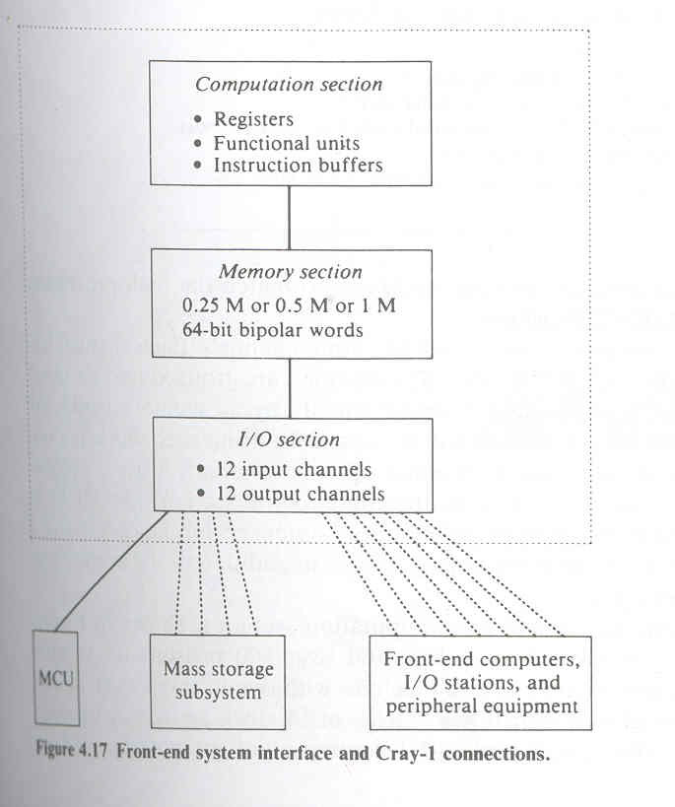
Architecture of Cray 1

Slide 2
Architecture of Cray 1
First modern vector processor
It consists of 800 registers, large instruction buffers and data buffers, 12 functional pipeline units.
Clock rate is 12.5 ns.
It is not a stand alone computer instead a host computer is required to serve as the system manager.

Slide 3
A front end system is connected to the Cray 1 via I/O channels.
The CPU contains a computation section, memory section, I/O section.
Twenty four I/O channels are connected to the front end computer, the I/o stations, MCU (maintenance control unit), mass storage subsystem.
The front end system will collect data ,present it to the Cray 1 for processing and receive output from Cray 1 for distribution to slower devices.

Slide 4
Computation Section
It contains 64X4 instruction buffers and 800 registers, 12 functional pipelines.
Arithmetic operations include 24 bit integer and 64 bit floating point computations.
There are 5 types of registers: 3 primary registers and 2 intermediate type registers
The three primary types of registers are address (A), scalar (S), vector (V) registers
,which are directly accessible by the functional units.

Slide 5
Computation Section
To support address and scalar registers, an intermediate level of registers exist which is not accessible directly by the functional units.
2 intermediate type registers:
  address save registers (B): intermediate register supporting address registers
  scalar save registers (T): intermediate register supporting scalar registers

Slide 6
Computation Section
eight 24 bit address registers used for memory addressing, shift counting, loop control, I/O channel addressing etc.
Data can be moved directly between bipolar memory and A registers or can be placed in B registers first and then moved to A registers.
There are sixty four 24 bit B registers. The B registers hold data to be referenced repeatedly over a sufficiently long period.

Slide 7
Computation Section
There are eight 64 bit S registers used for the storage of source and destination operands for the execution of scalar arithmetic and logical instructions.
Data can be moved directly between bipolar memory and S registers or can be placed in T registers first and then moved to S registers.
There are sixty four 64 bit T registers.
T registers access the bipolar memory by block read or block write instructions.

Slide 8
Computation Section
There are eight V registers. Each has 64 component registers.
A group of data is stored in component registers of a V register to form a vector operand.
A vector operation begins with fetching operands from the first component of a V register and ends with delivering the vector result to a V register.

Slide 9
Computation Section
The twelve functional units in cray 1 is organized into 4 groups: address, scalar, vector and floating point pipelines.
Each functional pipe has several stages. A functional pipe receives operands from the source registers and delivers the result to a destination register.

Slide 10
Computation Section
The address pipe performs 24 bit 2’s complement integer arithmetic on operands received from A register and delivers the result back to A register.
There are 2 address pipes: address add, address multiply.

Slide 11
Computation Section
Scalar pipes are for scalar add, scalar
shift, scalar logic and population-leading zero count.
Scalar pipes performs operations on 64 bit operands received from S registers and deliver the 64 bit result to the S register.
The scalar shift pipe can shift 64 bit operand in S register.
The population count pipe counts the number of 1’s in the operand. The leading zero count counts
the number of leading zeroes preceeding a 1 bit in the operand.
The scalar logical pipe performs the mask and boolean operations.

Slide 12
Computation Section
The vector pipe includes vector add, vector logic, vector shift.
These require operands from one or two V registers and an S register.
The floating point pipes are for FLP add, FLP multiply, reciprocal approximation over floating point operands. The reciprocal approximation pipe finds the approximate reciprocal of a 64 bit operand in the floating point format.

Slide 13
Memory Section
•It is organized in 8 or 16 banks with 72 modules per bank.
Bipolar RAM’s are used in the main memory with 1 million words of 72 bits .
In this 72 bit word, eight bits are used for single error correction and double error detection.

Slide 14
I/O Section
It contains 12 input and 12 output channels.
Maximum transfer rate is 80 Mbytes/sec
The channels are grouped into six input and six output channel groups and are served equally by all memory banks.
Four input and output channels operate simultaneously to achieve maximum transfer of instructions to the computation section.
The MCU monitors the system performance.
The mass storage subsystem provides large secondary storage.

